Slide 2

Agenda
01
Where we started
02
Our Journey
03
Our Team
04
Project Goals
05
Engineering Practices
06
Tech Stack
07
Development
08
UML Artifacts & Demo
09
Challenges & Learnings
10
Questions

Slide 3

The Ask – Where we started?
Just a group of college students, with a taste of development
Mostly worked on projects of small scale and priority
Either alone or in small groups of 2-3 members.
New to the Software design patterns and the planning process using diagrammatic tools.
Indifferent to deployment of the end product.

Slide 4

Our Journey

Slide 5
Timeline | Modules | Description
23rd Jan – 26th Jan | Unix commands Git commands UML Diagrams | Environment Setup Understanding Unix and Git commands Requirement analysis and modelling
27th Jan – 3rd Feb | Java 8 SQL Client-Service Model | Developing a POS Application using Java and MySQL. Understanding Java 8 features and collections
6th Feb – 8th Feb | Exception Handling Jersey DropWizard | Doing Exception Handling in our System Developing REST API using Jersey and DropWizard framework

Slide 6
Training Framework
13 DAYS
312 HOURS
18,720 MINUTES
11,23,200 SECONDS
LIMITLESS KNOWLEDGE

Slide 7

Our Team

Slide 8
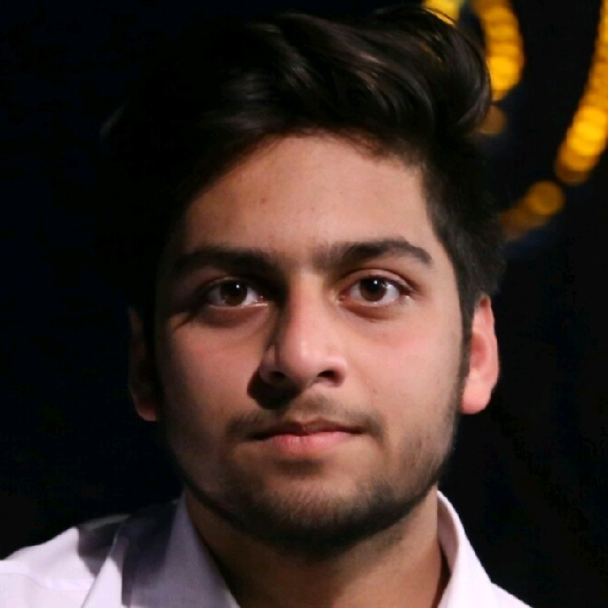
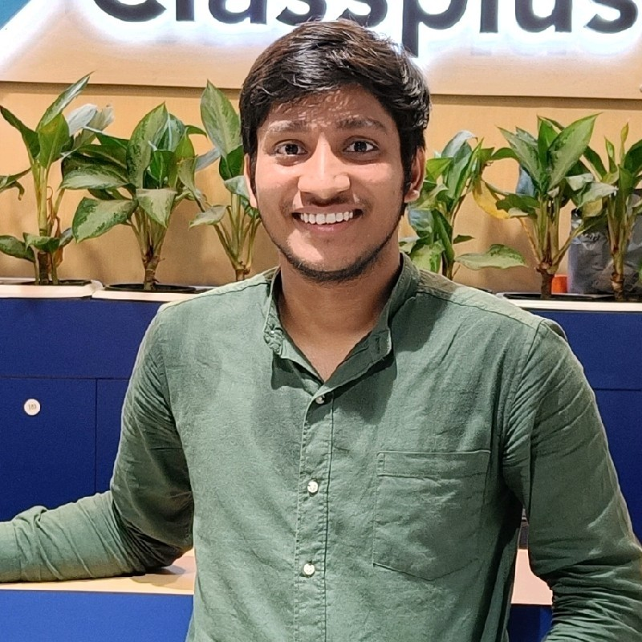
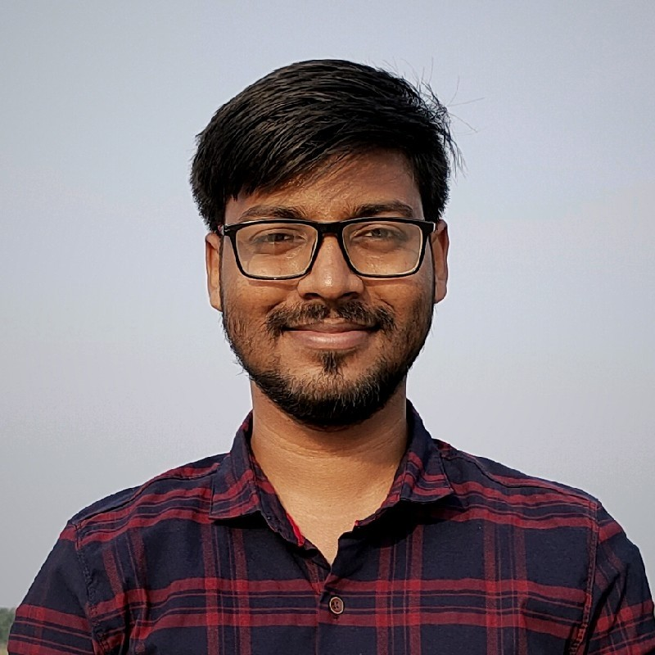
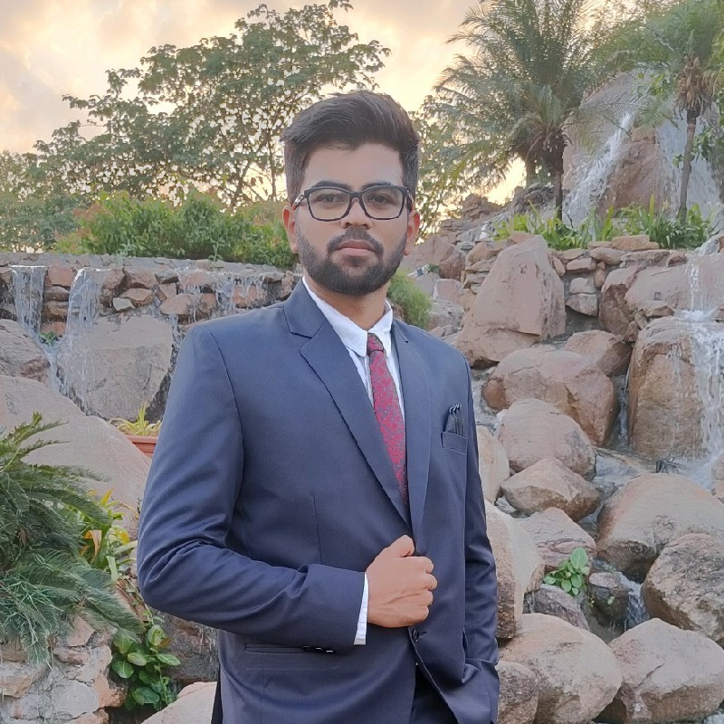
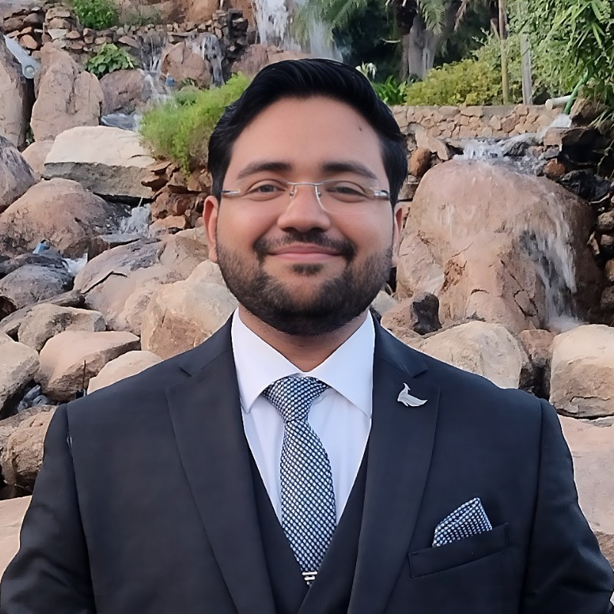

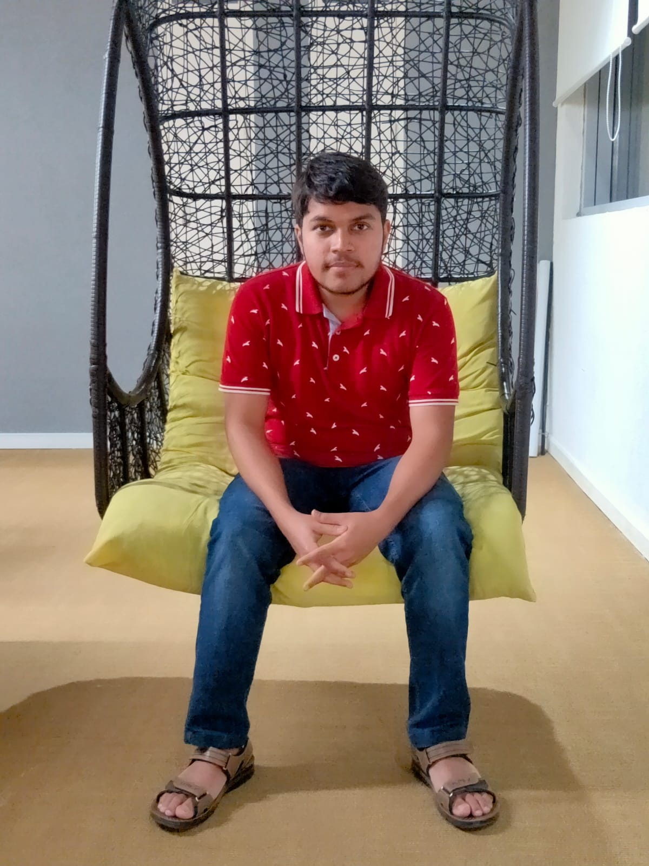
Raj Mittal
IIIT Lucknow
Kanhaiya Singhal
MNIT Jaipur
Manish Kumar
IIIT Lucknow
Shivam Agrawal
BITS Pilani Hyderabad Campus
Gaurav Dash
BITS Pilani Hyderabad Campus
(Group Leader)
Ashwin Kumar
IIIT Jabalpur
Archit Dalania
DAIICT Gujarat

Slide 9
Our next starts
NOW
Notes:
Time – 1 min

Slide 10

Project Goals
Notes:
Time – 3 mins

Slide 11




Our Vision
To create a Course Registration System using backend development tools and technologies, where professors and students can perform various registration related activities: like add/drop courses, grade students, view grades
1
2
Quality
Security
3
4
Interactivity
Speed

Slide 12
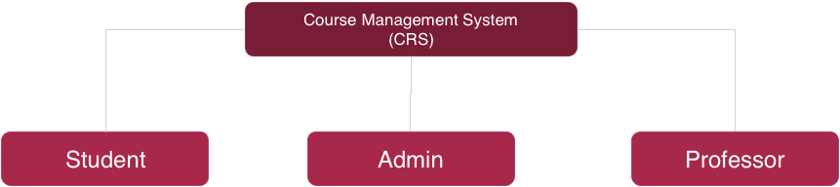
Add Professor
Assign Course to Professor
Approve Student Registration
Add/Delete Courses
View Pending Admissions
Update Catalog
Generate Report Card
Semester Registration
Register Courses
Add/Drop Course
View Registered Courses
Pay Fee
View Course Catalog
View Report Card
Grade Students
Select Courses to Teach
View Registered Students
View assigned Courses

Slide 13

Roles and Responsibilities
Gaurav - Admin Operation flows with UMLs and APIs.
Shivam- Professor Operation and API, Payment Operation.
Raj -Professor UML, Payment Operations.
Kanhaiya - Professor UML, User and notification system.
Manish - Registration flows with UMLs and APIs.
Archit - Admin UML , Admin and Student APIs.
Ashwin- Student Operation flows with UMLs and APIs.

Slide 14

Engineering Practices
Notes:
Time – 5 mins

Slide 15
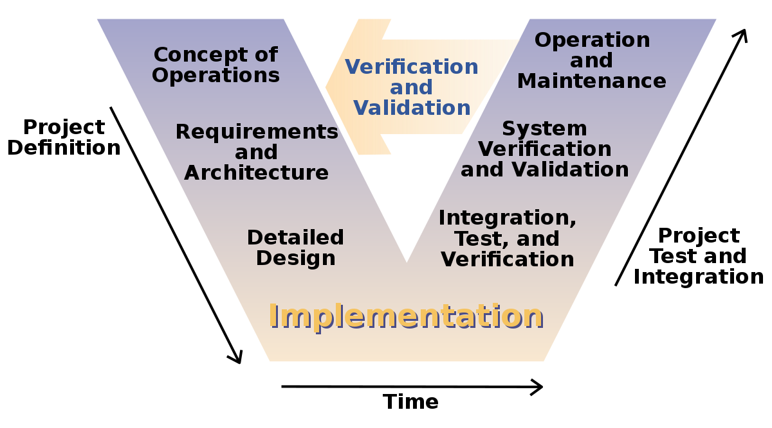

Slide 16
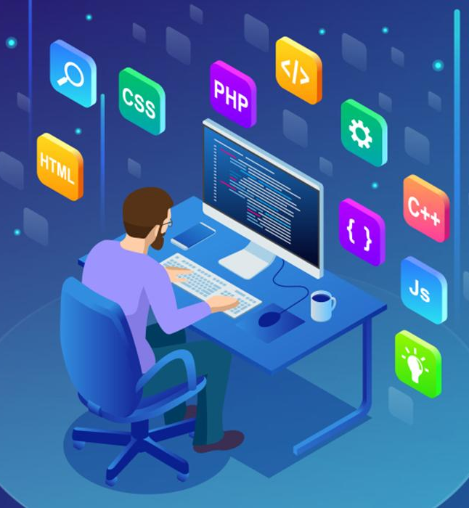
Tech Stack
Notes:
Time – 2 mins

Slide 17





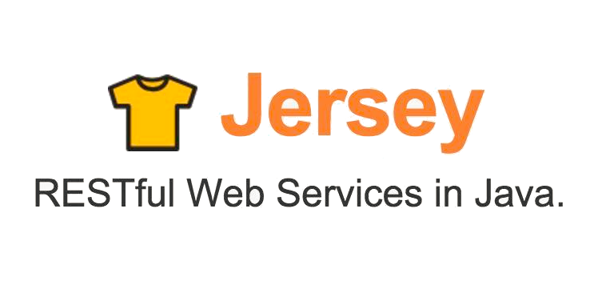




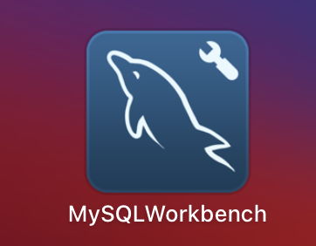

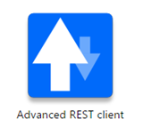



Design
Backend
Infra
Data
Tools
UML
Core Language
Build Automation Tool
SQL Database
Documentation
Frameworks
Testing
SCM
Application Server
Notes:
Time – 1 min

Slide 18

Development
https://github.com/MrRobot-29/Flipkart-JEDI-Group-F-CRS

Slide 19
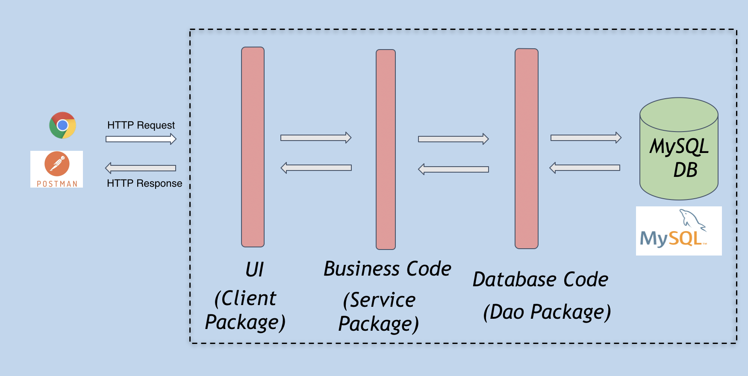

Slide 20
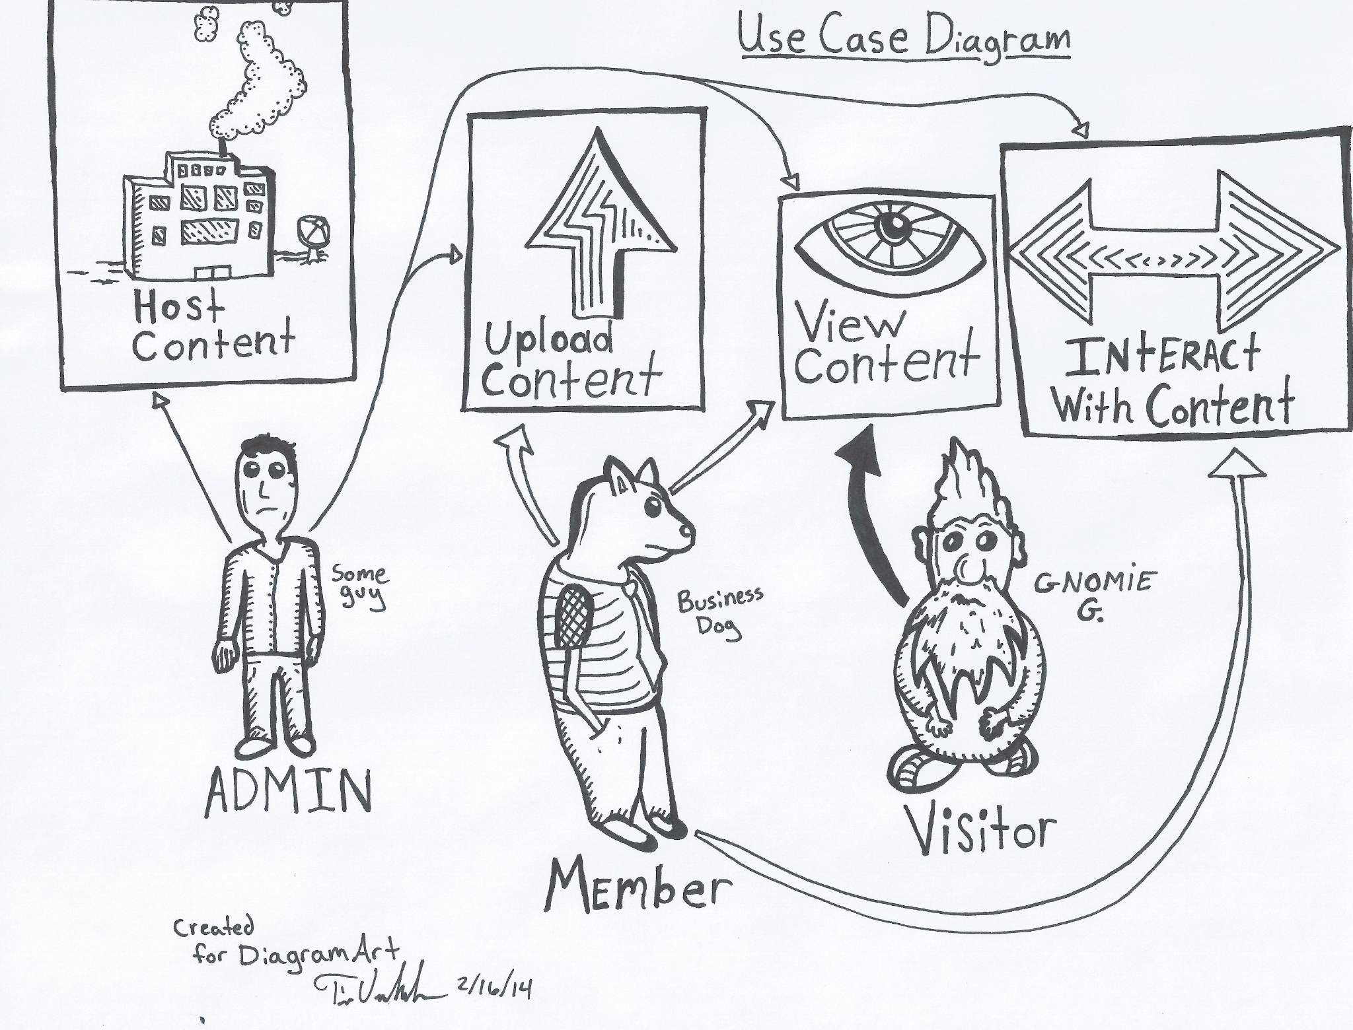
UML Diagrams

Slide 21
Use Case Diagram

Slide 22
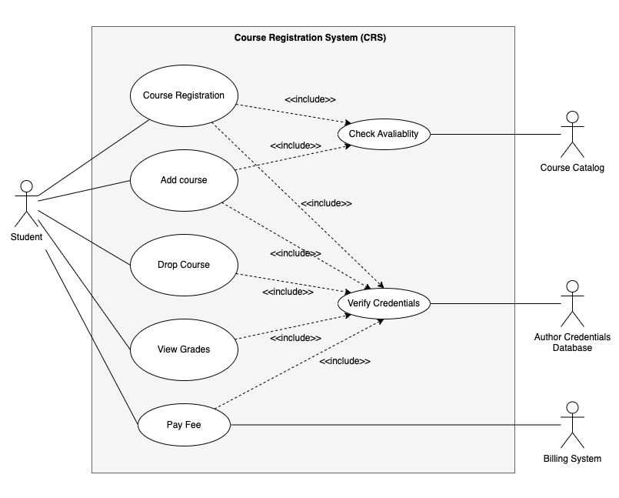
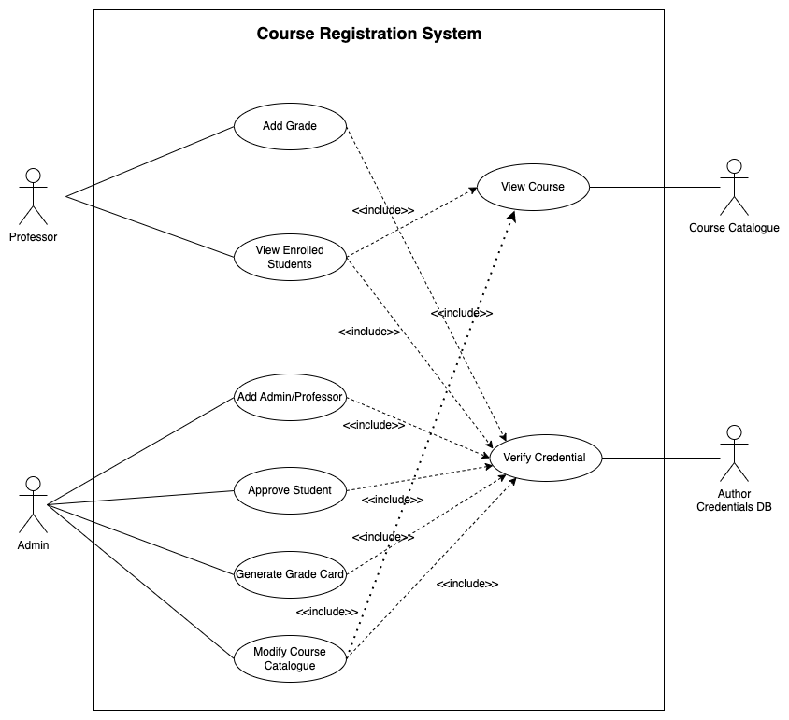

Slide 23
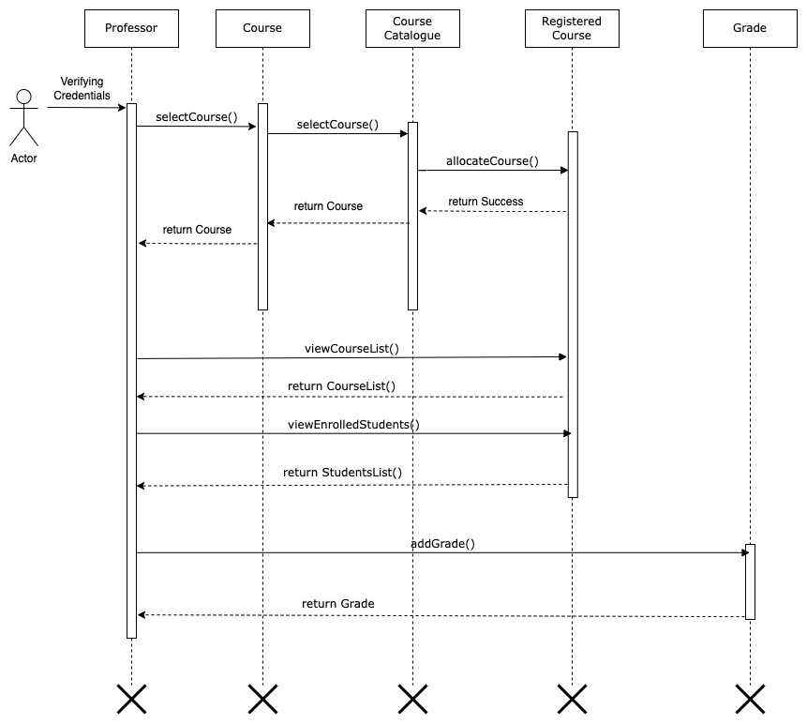
Sequence Diagram

Slide 24
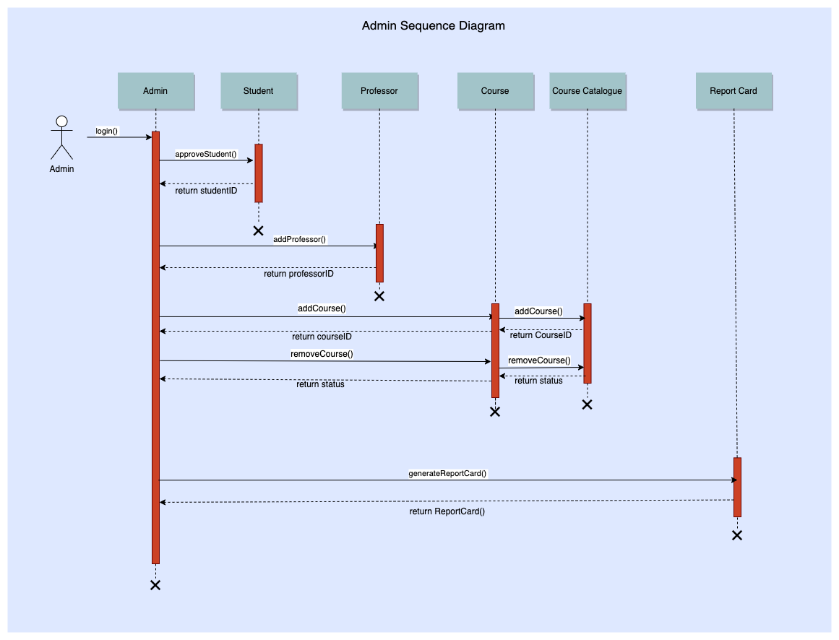
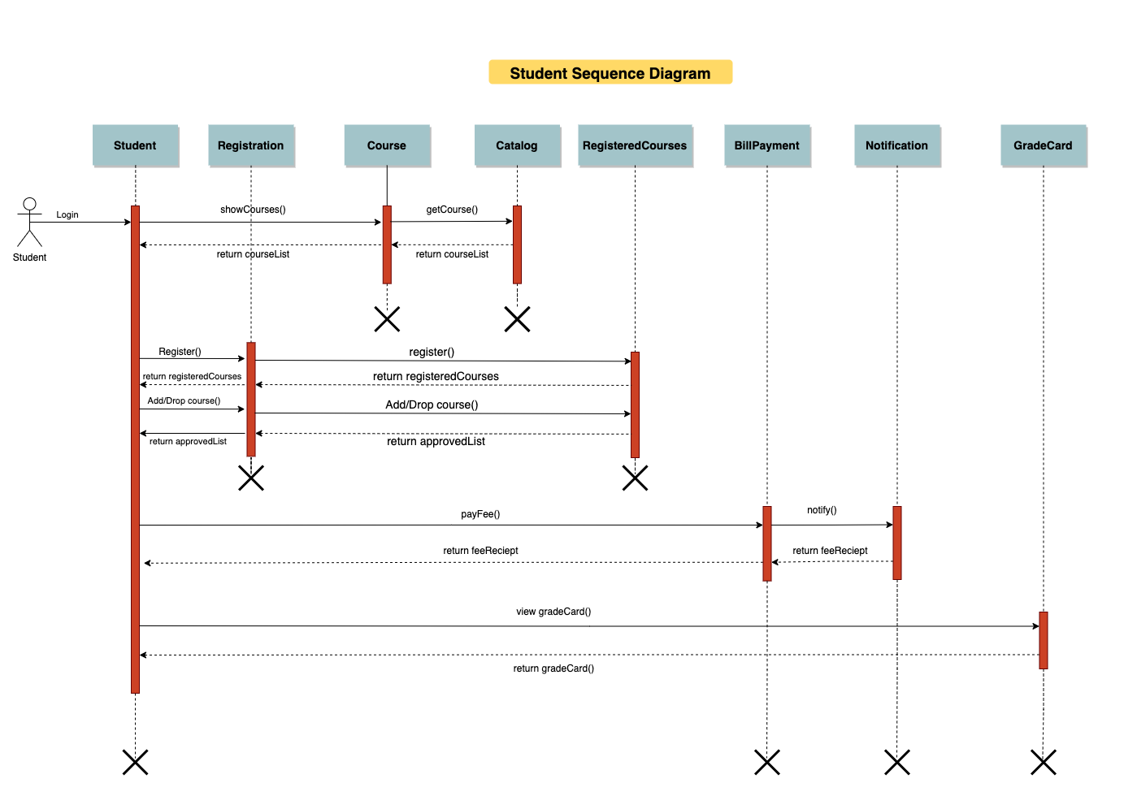

Slide 25
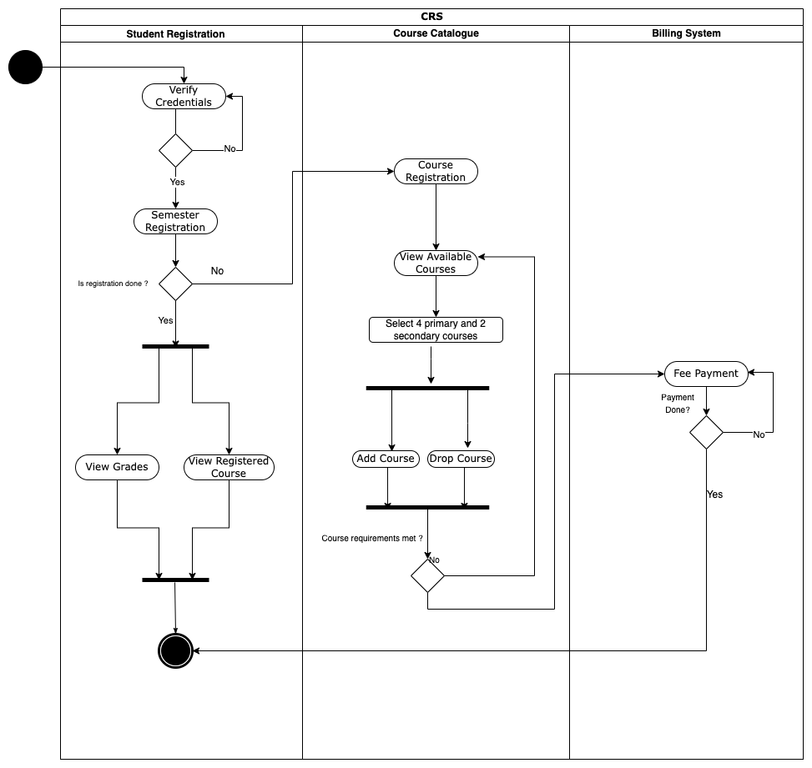
Activity Diagram

Slide 26
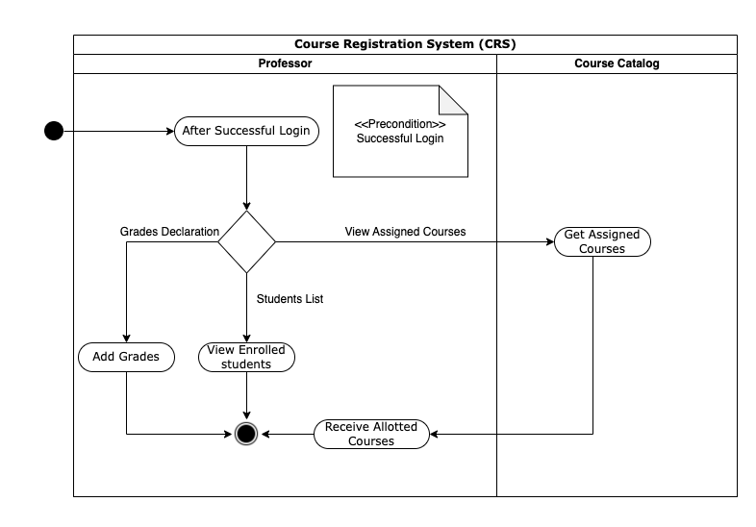
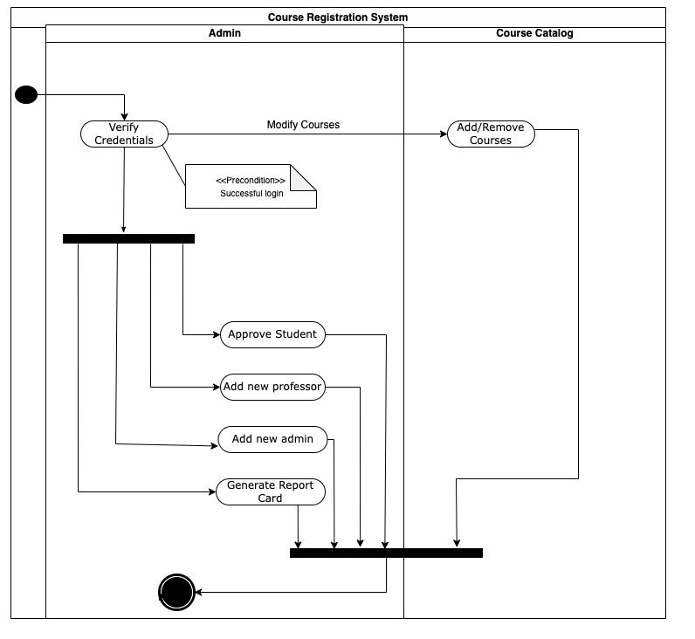

Slide 27
Class Diagram

Slide 28
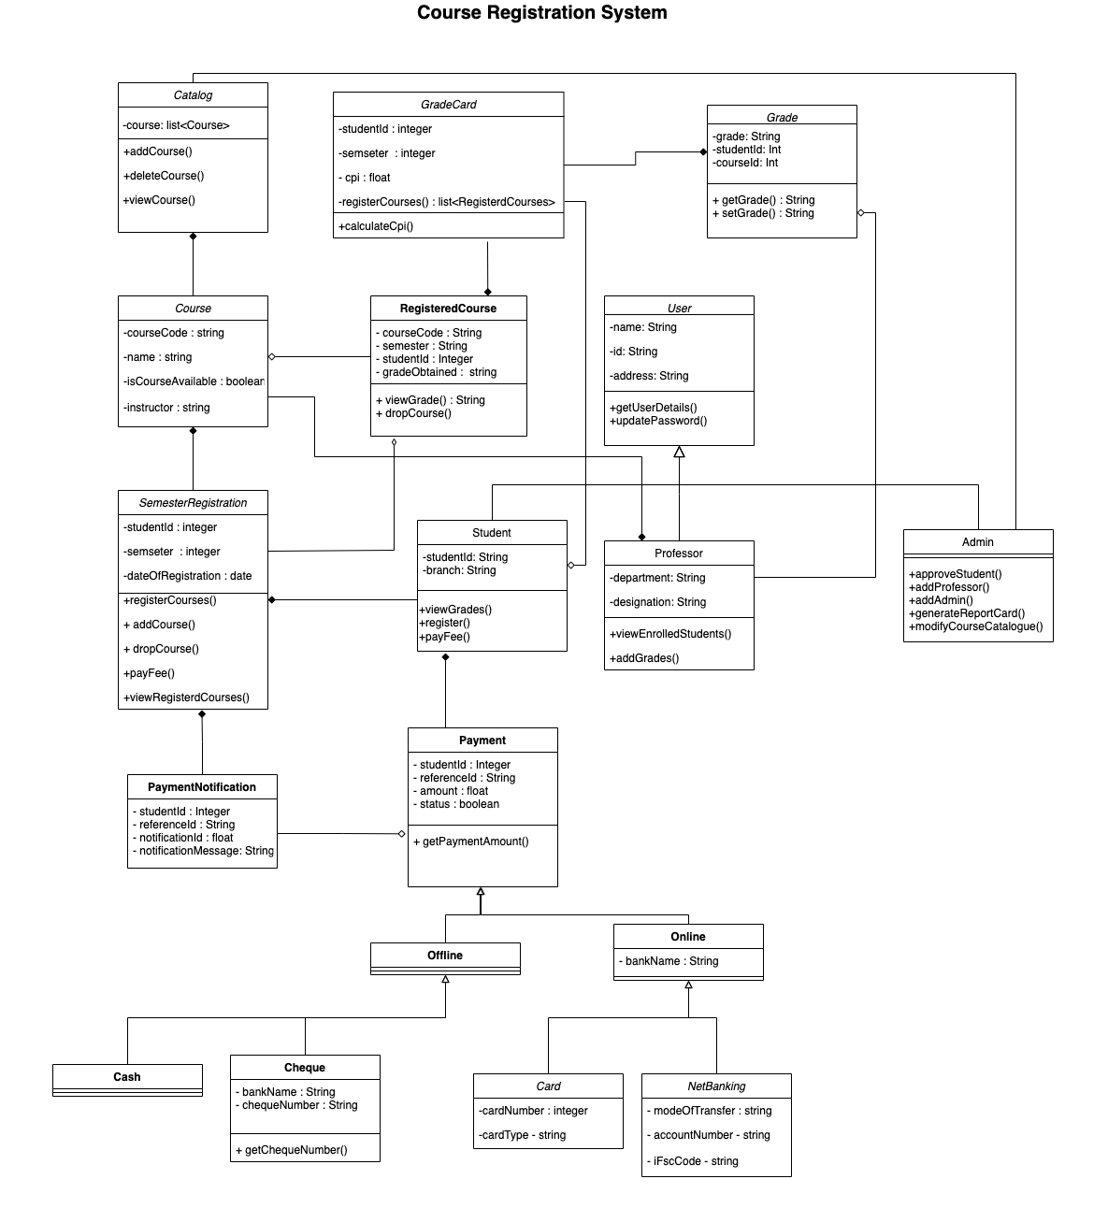

Slide 29
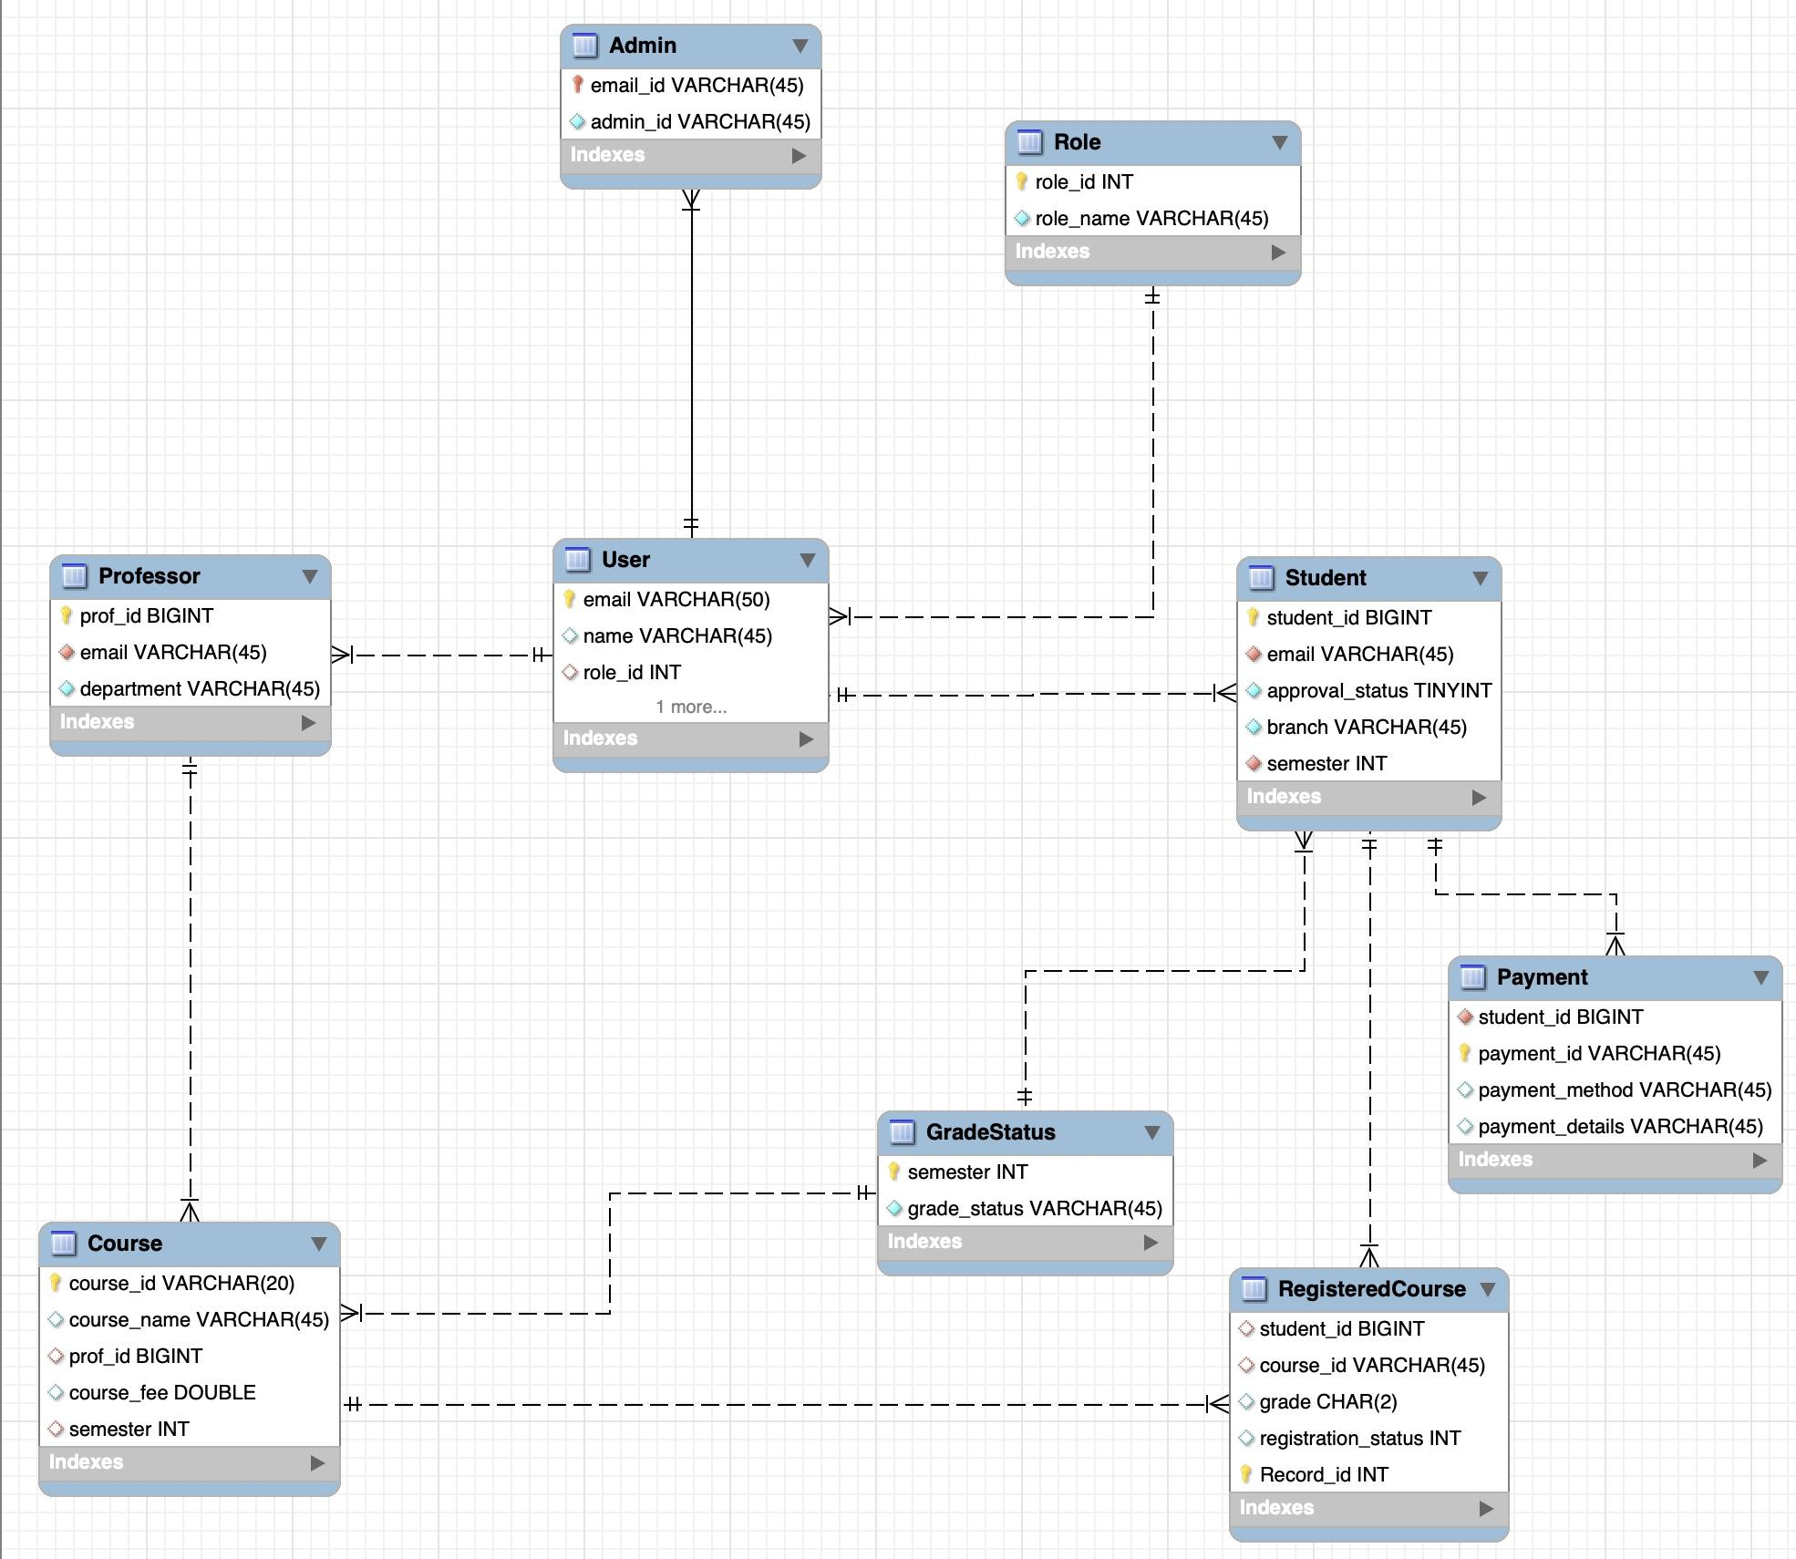
Database Schema

Slide 30

Demo

Slide 31

Challenges & Learnings
Notes:
Time – 2 mins

Slide 32
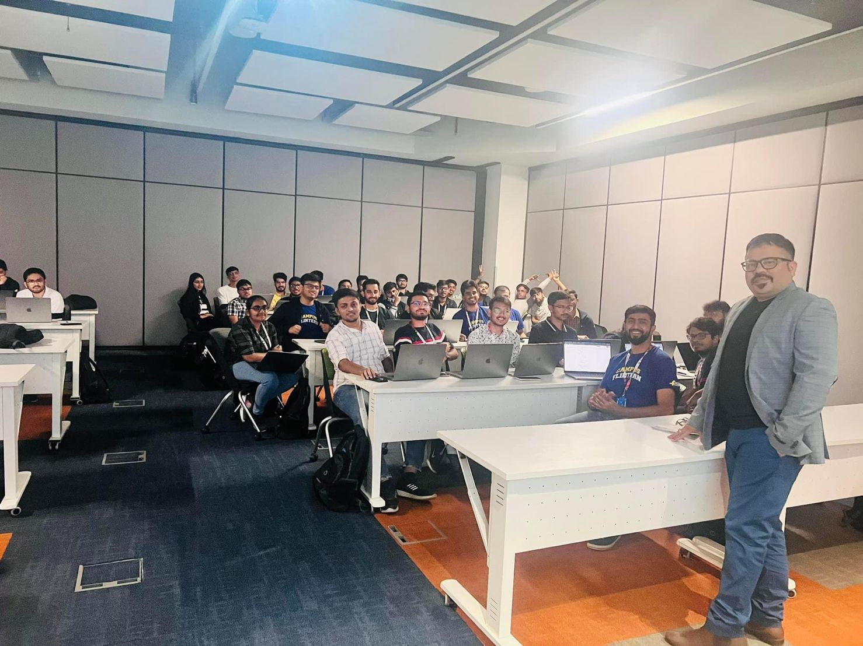
Learnings
Familiarization with UNIX and Git commands
Make efficient plans for the whole project with the help of UML Diagrams.
Object oriented approach with proper modularization and organization in JAVA, important for code reusability and efficiency.
Core Java 8 concepts, including advanced features like lambda expressions, singleton pattern, for each statements, etc.
Database maintenance and queries from MySQL with jdbc drivers.
REST API development using Jersey, Jackson API and dropwizard.

Slide 33

Challenges
Handling conflicts with many people working on the same project.(Git Helped)
Handling version mismatch for dependencies.
Come up with efficient use-cases with reusability for the different entities incorporating all the features given in the problem statement.
Environment set-up challenges because of different systems and compatibilities
Minimising and optimizing the Schema in database
Establishing Foreign key constraints.
Determining different exceptions that can occur in CRS System.

Slide 34

Questions
Notes:
Time - ?

Slide 35
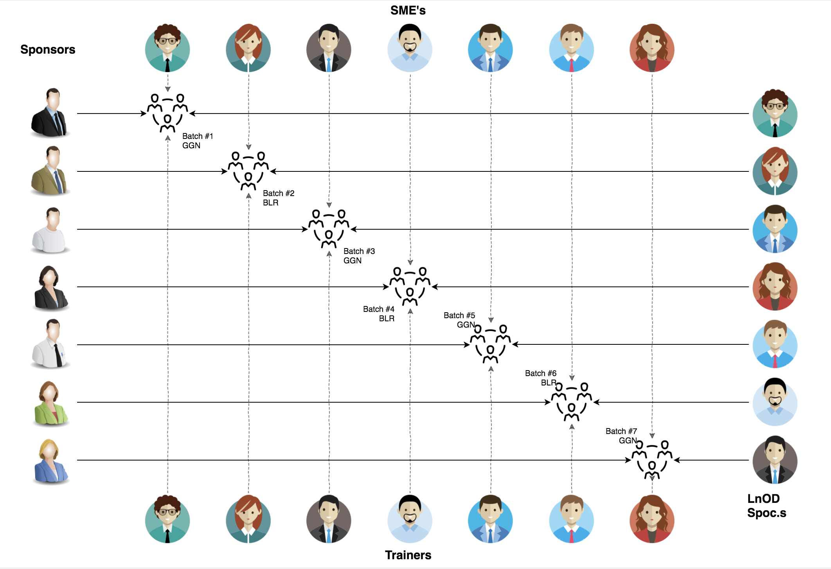
Stakeholders
Sponsors
Flipkart
SME’s
Amit Balyan
Training Coordinators
Sharath Ramesha
Heena Bansal
4. University Recruitment Team
Zain Inhonvi
Ankur Sinha
Anjali Verma

Slide 36
Thank you

